Slide 1

Data Professional
Survey Insights
This presentation explores key findings from a survey of data professionals. We'll examine demographics, job satisfaction, salaries, and career trends in the data industry.
Divya Prakash

Slide 2

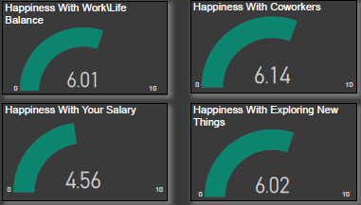
Work-Life Balance and Job Satisfaction
1
Work-Life Balance
Survey takers rated their work-life balance at 3.11 out of 10, indicating room for improvement.
2
Salary Satisfaction
Respondents rated their salary satisfaction at 6.10 out of 10, suggesting moderate contentment.
3
Coworker Relationships
Happiness with coworkers scored 4 out of 10, highlighting potential workplace dynamics issues.

Slide 3
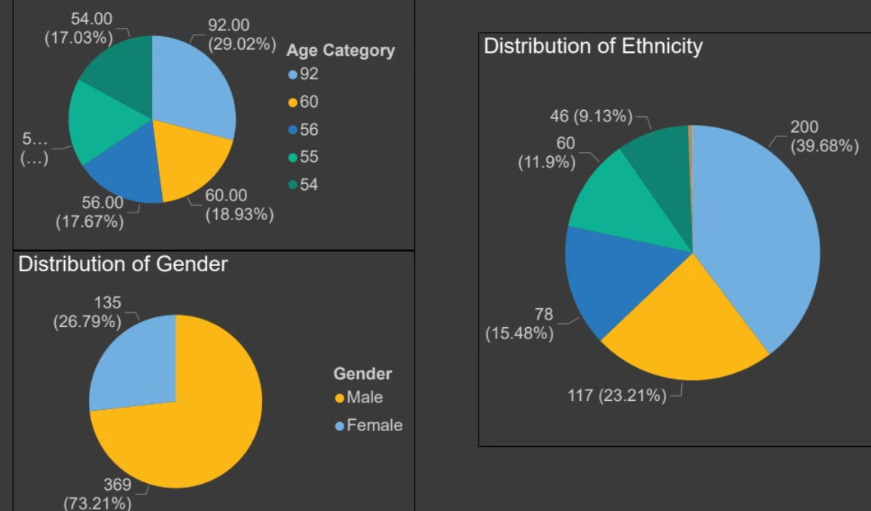
Demographic Overview
Age Distribution
The average age of survey takers was 29.63 years. This suggests a relatively young workforce in data professions.
Ethnicity
White or Caucasian respondents formed the largest group, followed by Asian or Asian American participants.
Education
Most respondents held bachelor's or master's degrees, indicating a highly educated workforce.

Slide 4

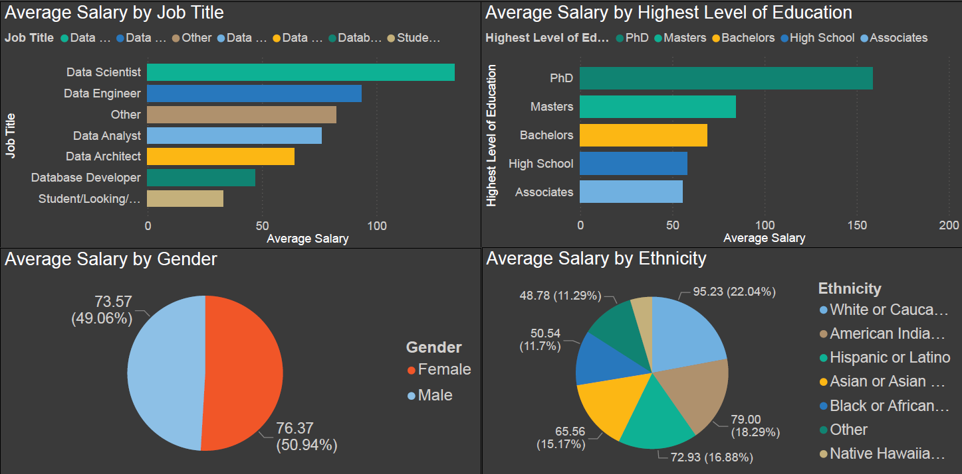
Job Title
Average Salary (₹K)
Data Architect
180
Salary Trends:
In Data career
Data Engineer
150
Data Scientist
140
Data Analyst
90
Database Developer
80

Slide 5




Gender and Education Salary Disparities
Gender Gap
Male data professionals earn slightly more on average, with a 3.8% difference in salaries.
Education Impact
Higher education levels correlate with increased salaries, with PhDs earning the most.
Ethnicity Factors
Salary variations exist among ethnic groups, warranting further investigation into potential biases.

Slide 6
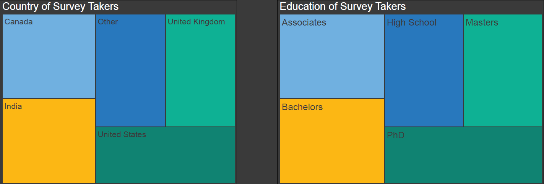




Geographic Distribution
United States
India
The majority of survey respondents were from the US, a leading data industry hub.
India represented a significant portion, reflecting its growing role in data professions.
United Kingdom
Canada
The UK emerged as a prominent European center for data professionals.
Canada showed a notable presence in the survey, indicating a robust data industry.

Slide 7
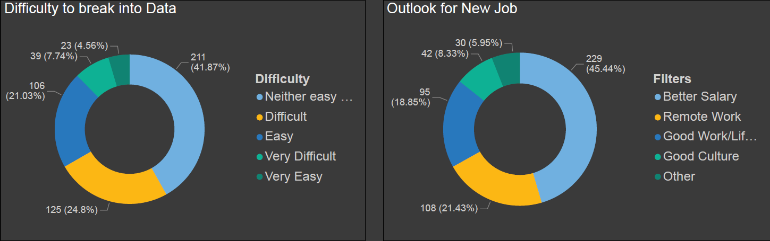
Career Transitions
1
Industry Shifts
Many professionals switched to data roles from other industries, indicating the field's appeal.
2
Job Title Changes
Career switches varied by job title, with data scientists showing high transition rates.
3
Entry Difficulty
Respondents rated the difficulty of entering data professions, providing insights for aspiring professionals.

Slide 8

Future Outlook
Salary Expectations
Better salaries are a primary motivator for job changes in the data industry.
Remote Work
The desire for remote work opportunities is increasingly important to data professionals.
Work-Life Balance
Improving work-life balance remains a key focus for attracting and retaining talent.
Company Culture
Data professionals value positive workplace cultures in their career decisions.

